Slide 1
The current Against All Odds web-course is an update of a television-based course originally produced in 1995 by the Annenberg-CPB project. The introduction to the original show went into far more detail.

Slide 2
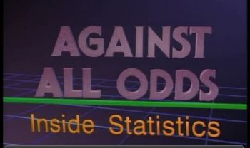

Slide 3
Examples of ways Statistics are used in business and in our everyday lives

Slide 4
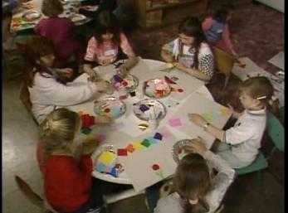
Does competition make children produce better artwork?

Slide 5
Two groups of children made collages.
Some were told they were competing for prizes.
Others thought it was just a party game.

Slide 6
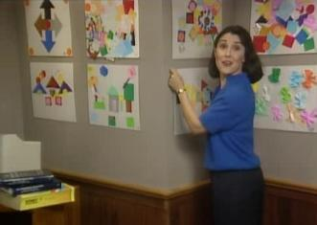
Art experts analyzed the finished work.
Result … Competitive rewards hurt creativity.

Slide 7
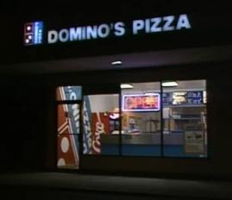
Domino’s Pizza

Slide 8
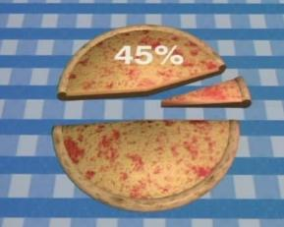
Domino’s wants to add deep dish pizza to their product line-up
Why? Because market research shows 45% of customers like it.

Slide 9
To see if the new pizza will work …

Slide 10
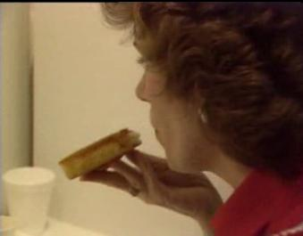
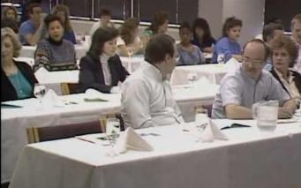
They have expert tasters rate different versions of the new pizza.
They give taste tests to members of the general public.

Slide 11
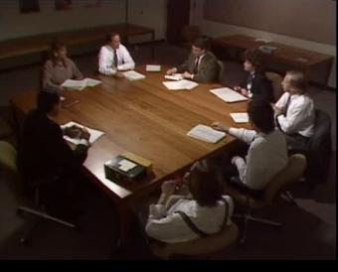
They analyze the type of customer who is likely to buy deep-dish pizza.
They hold strategy sessions to discuss marketing the new product.

Slide 12
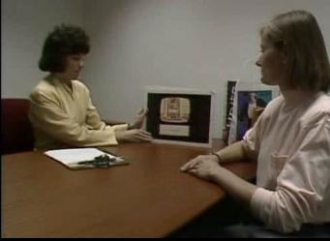
They stop people in shopping malls and ask them to view story boards of commercials for the product.

Slide 13
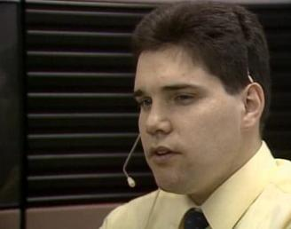
They test-market deep-dish pizza in selected cities and call people who buy it to get their reaction.

Slide 14
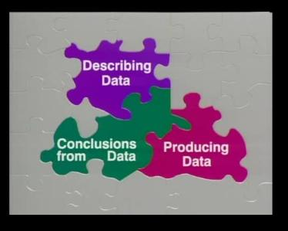

Slide 15

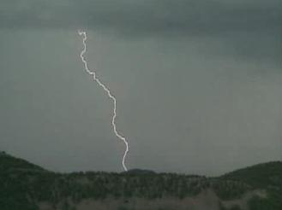
Examples of describing data
When does lightning first strike during the day?

Slide 16
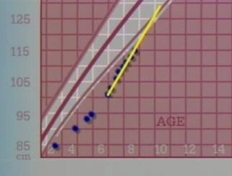
What is normal growth for a child, and when should they receive synthetic growth hormones?

Slide 17
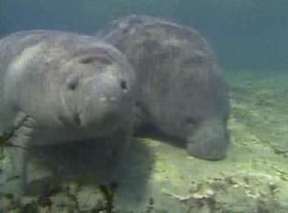
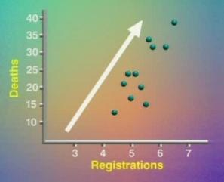
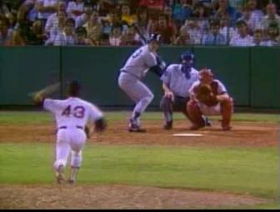
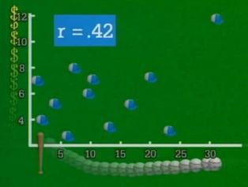
Are power boats killing manatees?
Do baseball players who hit more home runs earn higher salaries?

Slide 18

Examples of producing data
What effect do chemical plants have on shellfish in Chesapeake Bay?

Slide 19
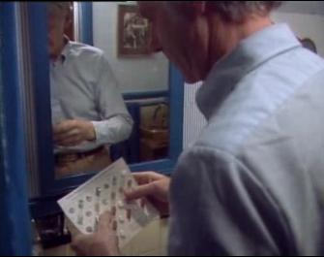
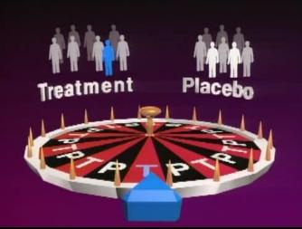
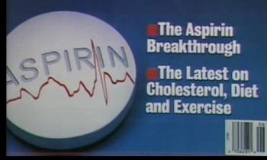
Does aspirin help prevent heart attacks?

Slide 20
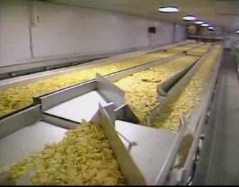
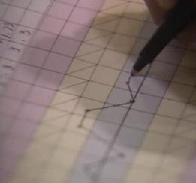
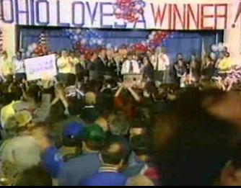
How can Frito-Lay ensure their potato chips are high quality?
Who will win an election?

Slide 21
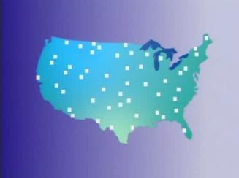
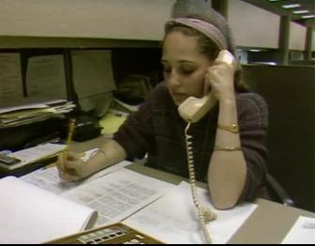
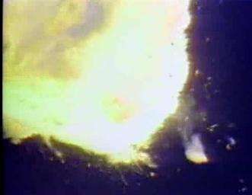
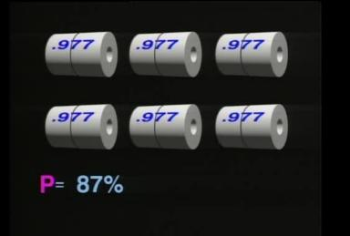
What do the American people think on different issues?
What made the Challenger space shuttle explode?

Slide 22
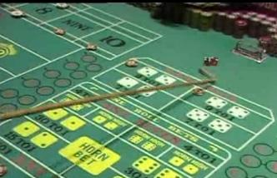
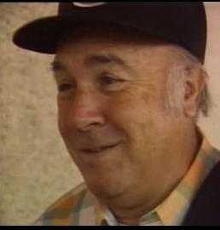
Why will the house always make money in a casino?
Quote from man at a casino: “If you win, you’ve got to quit while you’re ahead, or you’re a fool.”

Slide 23
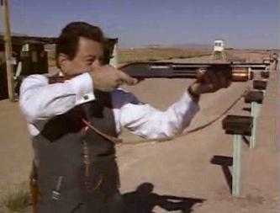
Examples of drawing conclusions from data
Are Hispanic agents being discriminated against in promotions given by the FBI?

Slide 24
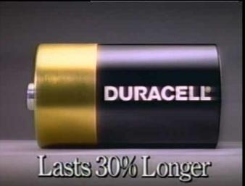

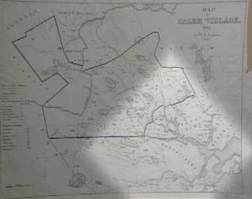
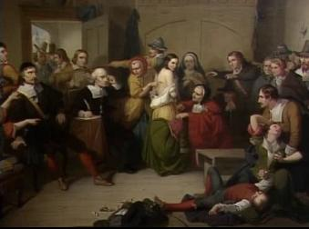
Does a new battery really last longer than the old one?
Why were people killed for being witches in colonial Salem?

Slide 25
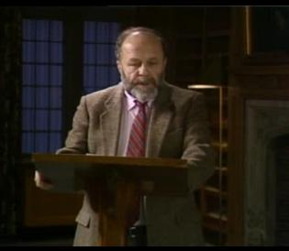
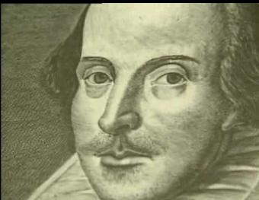
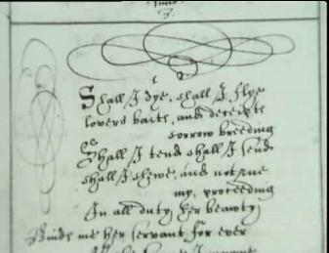
Could Shakespeare have written a newly discovered poem?

Slide 26
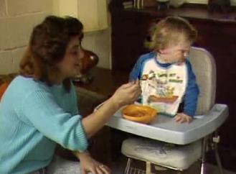
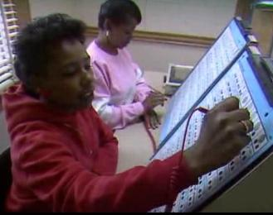
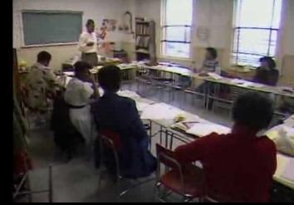
Does a new educational program help women to get off of welfare?

Slide 27
